Slide 1
Extract Heart Rate

Slide 2
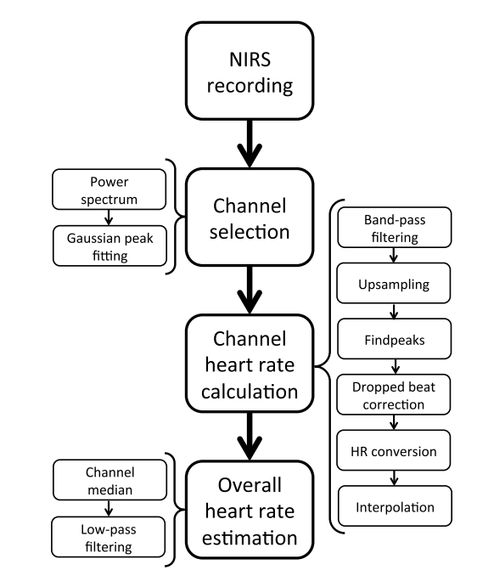
Extraction of heart rate from functional near-infrared spectroscopy in infants
Notes:
The HR was initially estimated for each channel separately.
First, the oxyhemoglobin (HbO) data for each selected channel
were upsampled from 10 to 100 Hz using a polyphase implementation
as provided with the RESAMPLE function in
MATLAB.
In adult fNIRS data, upsampling to 100 Hz from
the relatively low-initial sampling frequency of 10 Hz has
been shown to improve accuracy in HR estimation due to the
better time resolution of the estimation of the interbeat intervals.10
The HbO signal is often used in studies where a high
physiological signal content is desired.
11 The HbO signal was
filtered from 1.5 to 4 Hz using a third-order IIR Butterworth
filter to eliminate motion artifacts and low-frequency components.
Peaks in the HbO signal were found using the
FINDPEAKS routine in the MATLAB signal processing toolbox,
with a minimum spacing equivalent to 200 BPM.
Interpeak intervals were calculated, and intervals which were
longer than the mean interval plus three standard deviations
were assumed to include dropped beats and were, therefore, divided
in half. The standard deviation threshold was chosen using
a systematic parameter variation.
Instantaneous HR was calculated
from the inverse of the peak differences times and interpolated
to 20 Hz using the INTERP1 MATLAB routine. Finally,
an overall HR estimate was calculated by taking the median
HR over the selected channels at each time point, and the resulting
time series was low-pass filtered with a third-order IIR
Butterworth filter with a cutoff frequency of 0.3 Hz.
The filter
was applied in the forward and reverse directions to avoid phase
distortion. The low-pass cutoff frequency was chosen using systematic
parameter space exploration and was also required to
match the low-pass filter of the ECG HR estimate.

Slide 3
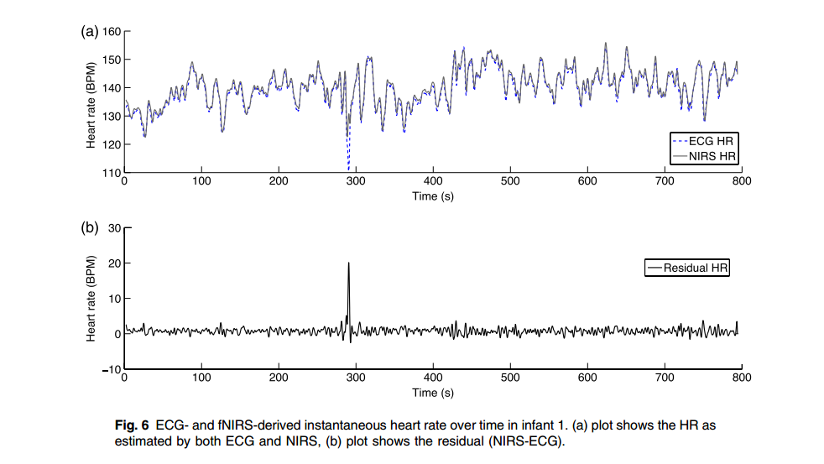
Extraction of heart rate from functional near-infrared spectroscopy in infants

Slide 4
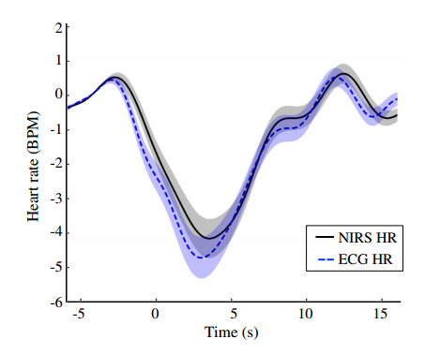
Extraction of heart rate from functional near-infrared spectroscopy in infants

Slide 5
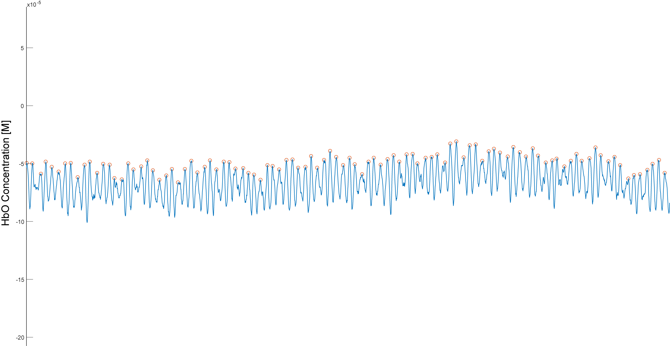
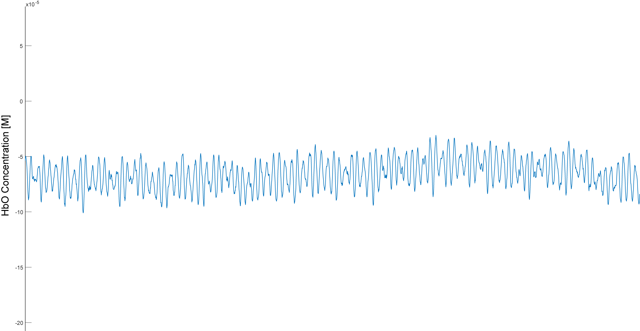
fNIRS Experiment 1 Channel Heart rate calculation

Slide 6
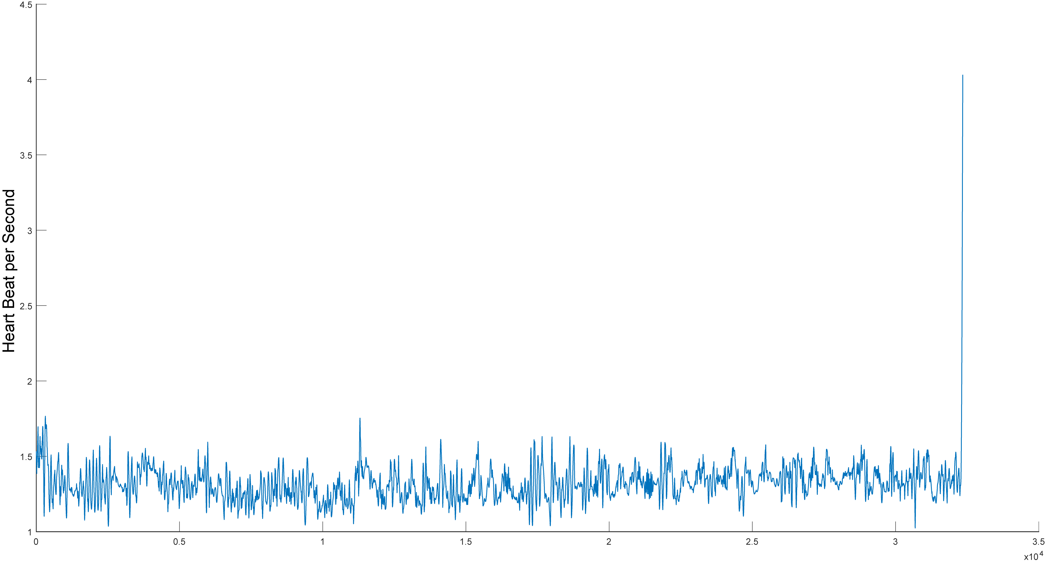
fNIRS Experiment 1 Channel Heart rate calculation

Slide 7
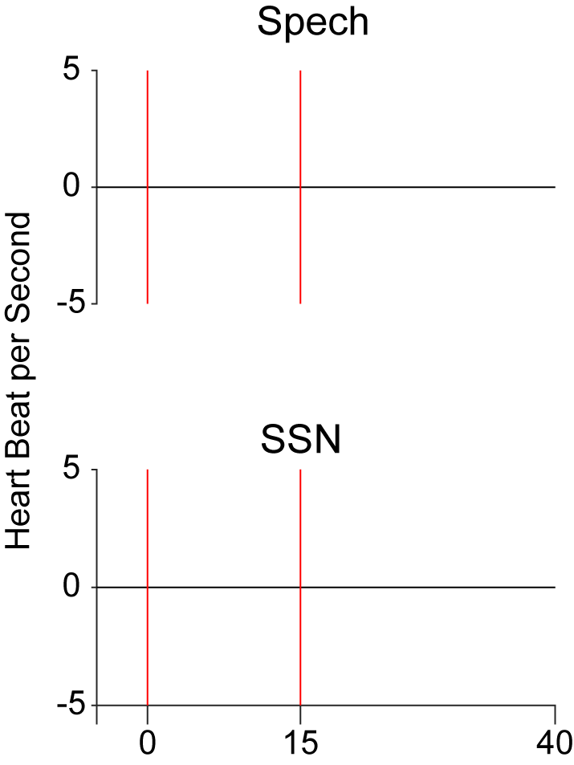
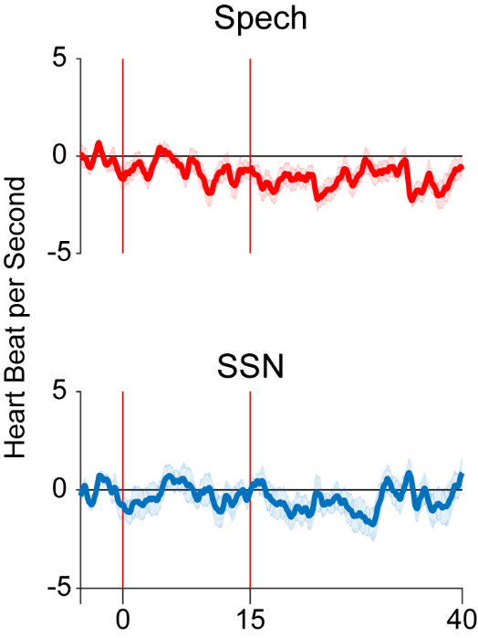
fNIRS Experiment 1 Overall heart rate estimation

